Slide 1
Sound Ontology
Update and Challenges

Slide 2
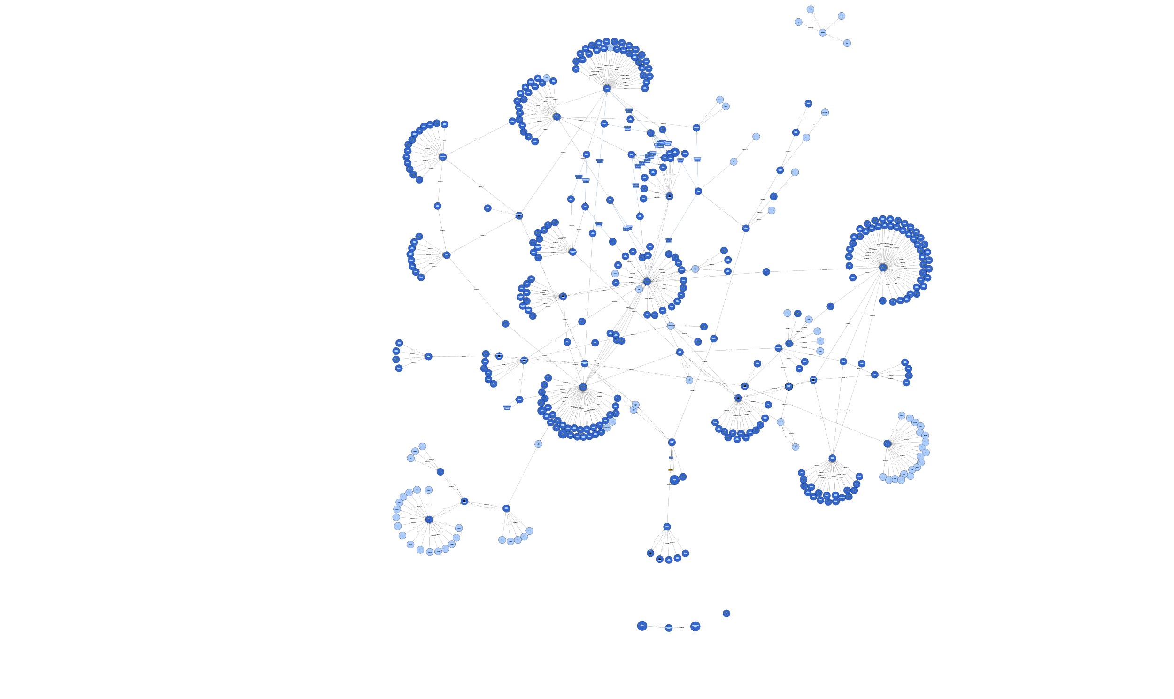
Current State

Slide 3
Questions
What is the difference between a sound and its mechanism?
Can a mechanism be defined for each sound?
How do categorize a sound unidentifiable sound? (Lobanova et al., 2007)

Slide 4
Sound vs. Sound Mechanism
Gaver (1993): sound-producing event =~ sound source
Example: “Human steps on wooden floor”
Mechanism = impact sound
Source = human (agent) feet and wooden floor (object)

Slide 5
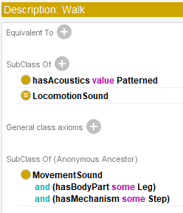
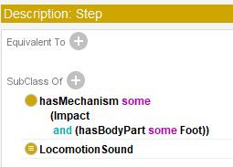
Sound vs. Sound Mechanism
What describes the sound best?
Walking, which involves step
Step
Impact interaction between foot and floor

Slide 6
Source Unidentifiable Sounds
“swish” can be produced by:
Fallen leaves and wind (aerodynamics)
Curtains (solid, fabric material)
Gramophone (plastic object)
Further examples: clink, rattle, plonk, gurgle…
Conclusion: for some sounds, source might not be the best categorization criterion

Slide 7
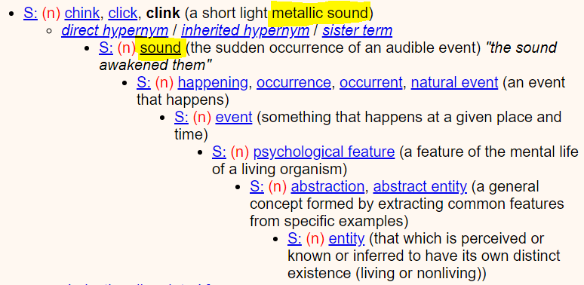
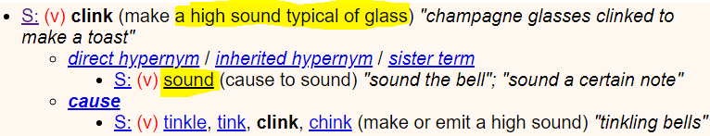
Source Unidentifiable Sounds (WordNet)

Slide 8
Source Unidentifiable Sounds (Alternative Criteria)

